Slide 1

Semi – Annual Presentation
Undergraduate Student Investment Management Fund – Team A
Friday December 4th, 2020

Slide 2








Team Introduction
Fund Manager
Fund Analysts
Jacob Robinson
Mike Miles
Daniel Johnson
William Sifert
Victor Diaz
Cynthia Arana
Benjamin Yue
Jacob Mosier
Student Investment Management Fund – Team A
Notes:
Name, major/minor, past professional experience, future career/internship plans

Slide 3
Table of Contents
Investment Thesis
Strategy Implementation
Student Investment Management Fund – Team A

Slide 4
Investment Thesis
Student Investment Management Fund – Team A

Slide 5
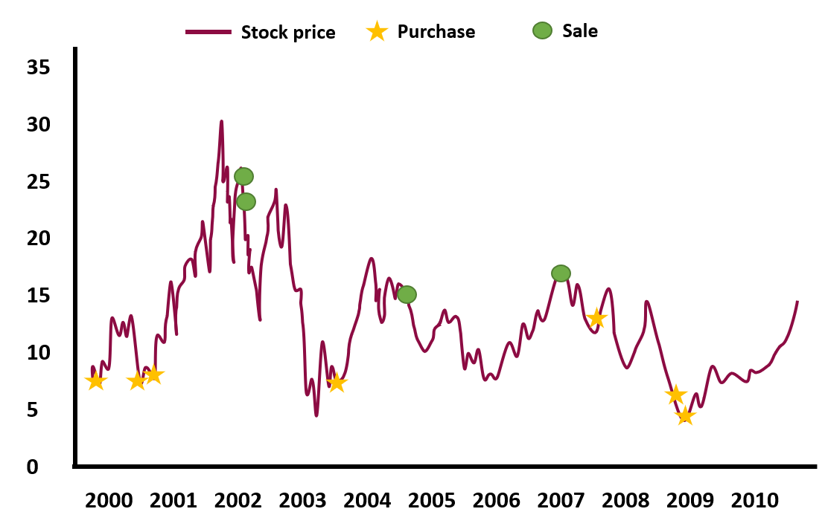
Investment Thesis
Akbas, Jiang, and Koch hypothesize that investment horizon of an insider establishes a pattern for expected trading behavior, thus helping them to identify unexpected trades.
Trading Record of Anonymous Insider
Bill Gates from 1996 - 2013
Vs.
Akbas, Jiang, and Paul D. Koch, 2020, “Insider Investment Horizon” The Journal of Finance 75, 1579-1627.
Student Investment Management Fund – Team A
Notes:
Recently in 2020, a paper entitled “Insider Investment Horizon” by Akbas, Jiang, and Koch was published in The Journal of Finance that examined the relation between insiders’ investment horizon and the relativity of the information associated with their trades with respect to future returns. An insider’s horizon helps establish a benchmark for an his/her trading pattern which in turn helps identify the unexpectedness of an insider’s trade which is has proven to be highly informative. Usually, the trades of short horizon insiders are both more unexpected and more informative than those of long horizon insiders. There are several types of trades that insiders can make, some of which contain information that move prices while others are simply systematic trades with no relevant information. This paper’s attempts to separate informative and non-informative trades. We will be attempting to mimic this investment thesis by following the trades of opportunistic insiders
This time series depicts the trading pattern of an anonymous insider who switches between buying and selling his company’s shares often between 2000-2010. This type of insider activity implies that the insider is more likely interested in short-term objectives and therefore would be classified as a short horizon insider. This graph also shows the clear arbitrage opportunities available if one were to successfully follow the trades of these opportunistic insiders.

Slide 6
Targeting Short Horizon Insiders
Short horizon insiders outperform long horizon insiders, additionally short horizon insiders have greater predictive power.
Insider
Long Horizon (LH)
Uninformative
Deviation from (LH)
Short Horizon (SH)
Informative
Akbas, Jiang, and Paul D. Koch, 2020, “Insider Investment Horizon” The Journal of Finance 75, 1579-1627.
Student Investment Management Fund – Team A
Notes:
When insiders trade, they may trade with information that has a long horizon in which they expect to gain market share over a long period of time. However, they may also trade with information that has a short horizon such as information about improvements in profit margins. Our team will be primarily focusing on mimicking the trades of short horizon insiders as they have historically proven to be more informative, and they oftentimes move prices quicker over a short period of time.

Slide 7

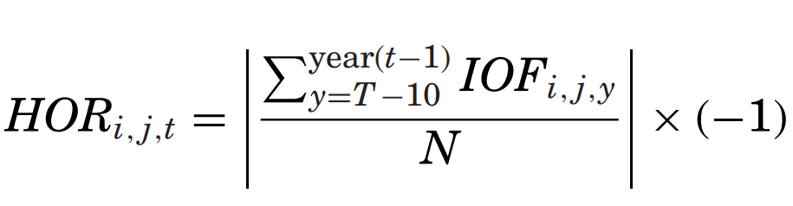
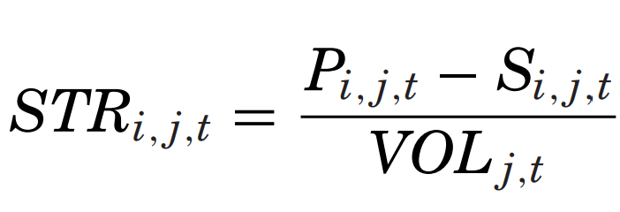
Measuring Insider Horizon and Strength
Akbas, Jiang, and Koch use Horizon (HOR) and Strength (STR), these two variables help them measure insider trading.
Annual net insider order flow
=
-1 | -0.5 | 0
Long Horizon | Mid Horizon | Short Horizon
Lower STR | Higher STR
Weaker Purchase | Stronger Purchase
Akbas, Jiang, and Paul D. Koch, 2020, “Insider Investment Horizon” The Journal of Finance 75, 1579-1627.
Student Investment Management Fund – Team A
Notes:
The paper defines the investment horizon of an insider as his or her average annual net insider order flow over the identification period which is equal to (shares purchased - shares sold/shares purchases + shares sold). The purchases and sales are calculated per insider, firm, and year. The IOF is then summed for each year that a specific insider traded, and that number is divided by N (# of years the insider traded). Like the paper, we will require the insider to have traded at least 4 of the past 10 years to be included in the sample (N>=4). This value can range from -1 to 0 (0 meaning their purchases and sales offset each other).
The paper also measures the strength of the signal evident in an insider's trading activity by creating another measure of the magnitude of the insider’s order flow during a month as a fraction of total trading volume in the stock for each insider. VOL is the total volume of shares traded by all the investors at a specific firm during a specific time period.

Slide 8
Comparison of Monthly Returns
Return comparison between different horizons (HOR), constrained to a strong purchase signal based on strength index (STR).
Akbas, Jiang, and Paul D. Koch, 2020, “Insider Investment Horizon” The Journal of Finance 75, 1579-1627.
Student Investment Management Fund – Team A
Notes:
This graph depicts the average monthly returns for long, medium, and short investment horizons with strong signals in insiders’ trades. It Is evident that the returns generated from short horizon purchases are significantly higher than those of long horizon purchases. This is true in both the raw returns and in the risk-adjusted abnormal returns from the Fama-French four factor alpha returns.
Therefore, our goal is to capture the returns associated with short horizon trades to maximize our alpha.

Slide 9
Long Horizon Insider Deviation
When long horizon insiders deviate from their expected patterns of buying/selling, these trades are even more informative than the typical short horizon insider’s trade.
Insider
Long Horizon (LH)
Uninformative
Deviation from (LH)
Short Horizon (SH)
Informative
Akbas, Jiang, and Paul D. Koch, 2020, “Insider Investment Horizon” The Journal of Finance 75, 1579-1627.
Student Investment Management Fund – Team A
Notes:
So far, we have discussed that short horizon insiders’ trades are more informative than those of a long horizon insiders’ trades due to the fact there is a higher degree of unexpectedness associated with insiders that trade over shorter investment horizons. However, on the rare occasion that long horizon insiders deviate from their expected trading patterns, these trades are likely to be even more unexpected and thus even more informative than the more typical unexpected trades of short horizon insiders.

Slide 10
Unexpectedness in Long Horizon Insiders
Unexpectedness determines how far a given purchase of a long horizon insider deviates from the benchmark expectation associated with the insider's investment horizon.
-2 | -1 | 0 | 1 | 2
Unexpected Sales from LH | Unexpected Sales from SH | Expected Purchase from LH | Unexpected Purchases from SH | Unexpected Purchases from LH
Akbas, Jiang, and Paul D. Koch, 2020, “Insider Investment Horizon” The Journal of Finance 75, 1579-1627.
Student Investment Management Fund – Team A
Notes:
We will be using the unexpectedness formula to measure the deviation from the expected benchmark that is associated with an insider’s horizon. This measure is given by the difference between an indicator variable for the current month’s trading direction and the average annual net insider order flow across all calendar years in which the insider traded over the identification period. This value can range between 0 and +2 if the insider buys shares. Purchases that contain a more positive number indicates that they are more likely to be informative about future stock returns.
We will look at each day’s trade to see if it is different from historical trades to determine if relevant information is present.

Slide 11
Returns of Unexpectedness
Akbas, Jiang, and Paul D. Koch, 2020, “Insider Investment Horizon” The Journal of Finance 75, 1579-1627.
Student Investment Management Fund – Team A
Notes:
This graph depicts the monthly returns when the long horizon insider has made a rare purchase with an unexpectedness of +2. It also shows the monthly returns when the long horizon insider had made an expected purchase. It is evident that the returns generated from an unexpected long horizon insider’s trade are significantly higher.
Therefore, we will be checking each day to see if the trade has a high level of unexpectedness associated with it as it has the potential to generate an incredibly high alpha.

Slide 12
Strategy Implementation
Student Investment Management Fund – Team A

Slide 13
Portfolio Construction Overview
Collect historical data on universe of equities
Historical insider data processed to calculate historical horizon (HOR)
Scraper runs on SEC fillings collecting current data
Hold and rebalance every calendar month
Calculate: Short and Long horizon trades based on UNEXP and STR
Invest in equities that match HOR and STR criteria
Phase 1
Phase 2
Student Investment Management Fund – Team A

Slide 14
Equities Universe
100% equities
> $500M market cap
Daily volume >50k shares
Selected Universe
At least 4 years old
Total of 1900 Equities
Student Investment Management Fund – Team A

Slide 15
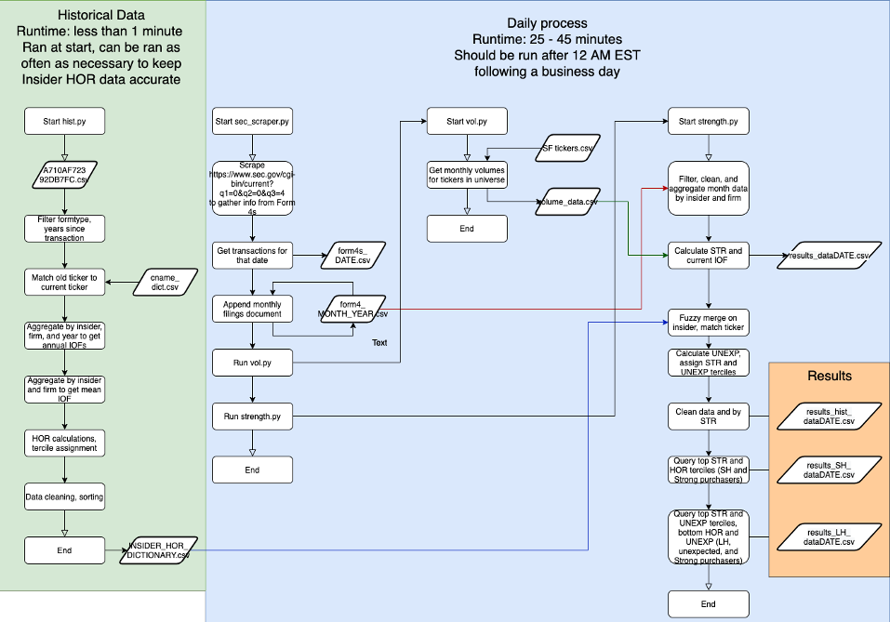
Data Process In Depth
Student Investment Management Fund – Team A

Slide 16
Portfolio Weighting
Horizon | Factor | Assigned Weight
Short Horizon | Strength (STR) | 1.5% allocation
Long Horizon | Unexpectedness (UNEXP) Strength (STR) | 2% allocation
Student Investment Management Fund – Team A

Slide 17
Rebalancing Process
To mitigate turnover, equities are held for one month. This is consistent with Akbas, Jiang, and Koch.
Retrieve new trades from scraped data in Python (daily)
Assign weights and purchase equities
Hold equity for one month from transaction date
Sell equities at end of one month holding period
Student Investment Management Fund – Team A

Slide 18
Where We Are Now
Building Portfolio
3 trades so far
30 possible trades in November
Awaiting New Trades
Expect to see SH trades almost daily
LH unexpected trades rare
Began trading on 11/24
Student Investment Management Fund – Team A

Slide 19
Thank You. Questions?
Student Investment Management Fund – Team A

Slide 20

Student Investment Management Fund
Fall 2020 Presentation: Team B

Slide 21








SIM Fund Team B
Fund Manager
Fund Analysts
Paul Resczenko
Von Brady
Jacob Wilson
Albert Zatonskiy
Jacob Robinson
Logan Saker
Mina Girgis
Rishab Kohli

Slide 22
Investment Thesis
-
Value – Profitability – Momentum

Slide 23
Portfolio Strategy
Value
Target Universe
Cash Based Operating Profitability
Momentum

Slide 24
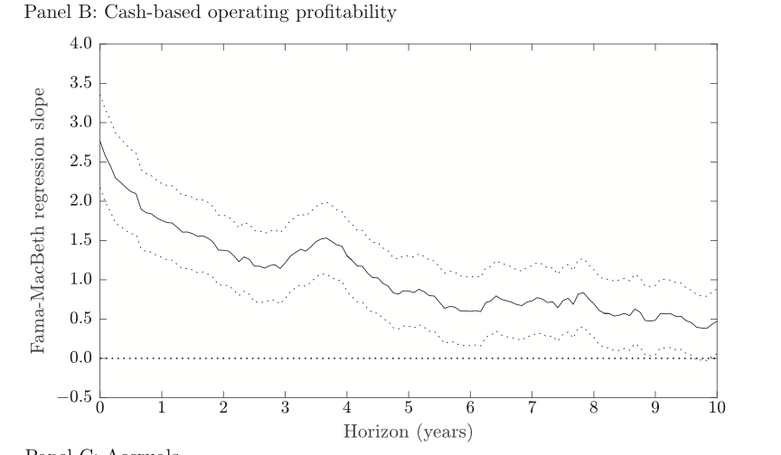
Cash-Based Operating Profitability
CBOP is a stronger predicter of future returns than profitability alone.
Hedge against unprofitable value stocks.
CBOP is expected to result in higher Sharpe ratios.
Profitability
Profitability
Source: Ball Et all., Journal of Financial Economics
𝑦 = ⍺ + β_{MKT}MKT + β_{RMW}RMW_{cbOP}
+ β_{HML}HML + β_{UMD}UMD + ∈

Slide 25
Value
Overvalued
Market Value
True Value
Undervalued
Market Value
Time
𝑦 = ⍺ + β_{MKT}MKT + β_{HML}HML + β_{RMW}RMW_{cbOP} + β_{UMD}UMD + ∈

Slide 26
Momentum
Exclude
Include
𝑦 = ⍺ + β_{MKT}MKT + β_{RMW}RMW_{cbOP}
+ β_{HML}HML + β_{UMD}UMD + ∈

Slide 27
Portfolio Development/Implementation Process
Rebalance Monthly
Source data from Bloomberg: Accounting and Stock Returns
Input stock data into Portfolio Model
Calculate Cash Based Operating Profitability Ratio
Calculate YTD Returns & Price/Book Ratio
Apply Factor Weights & Rank Stocks
Sort by Sector, Weight Stocks, & Invest in top 65 Stocks according to Rank
Phase 1
Phase 2
Phase 3

Slide 28
Selecting the Investable Universe
Target Investable Universe: ~ 3,000 Stocks
Target Universe
Trading Volume 1 Day Ago >50,000 Shares
Market Cap >= $500 Million
Country of Domicile: United States
Charter Requirements
Common Equities Only
Total Universe of Securities
Building & Rebalancing the portfolio requires an initial screening in Bloomberg to reduce the universe of securities to a manageable level, removing any that fall outside of ASU Charter Requirements.

Slide 29
Required Stock Data: Bloomberg
Cash-Based Operating Profitability
Value
Momentum
Price/Book Ratio
Ticker
Common Equity
$ Free Cash Flow: Current Quarter
Market Capitalization
Stock Price
Free Cash Flow to Equity Ratio
Sector
Return on Equity: ROE
Operating Profit: Current Quarter
Δ Accounts Payable: Quarterly
Δ Accounts & Notes Receivable: Quarterly
Δ Accrued Expenses: Quarterly
Δ Inventories: Quarterly
Total Return %: 1-Year
Total Return %: YTD
Sharpe Ratio: YTD

Slide 30
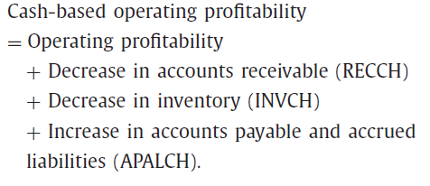
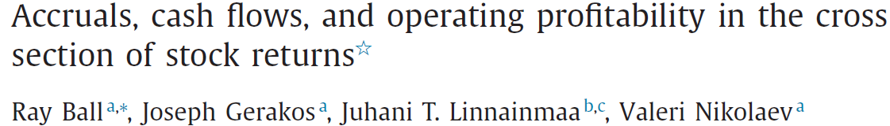
Cash Based Operating Profitability Ratio
Operating Income (Losses): Current Quarter
Accounts & Notes Receivable: Q & Q-1
Inventories: Q & Q-1
Accounts Payable: Q & Q-1
Accrued Liabilities & Expenses: Q & Q-1
Total Equity
The resulting numerical figure will be added to the Value and Momentum factors, producing the final ranking used to select the highest 65 stocks for the portfolio.
Solution is Factored into Final Stock Ranking
Applies Factor Weighting
Model Calculates CBOP Ratio
Equity

Slide 31
YTD Returns (Momentum)
Momentum Factor
Applied as a function of YTD Returns and Factor weighting.
Stocks with superior returns are given preferential ranking in portfolio model.
Stocks with positive returns in one period tend to continue to perform well in follow-on periods. Jegadeesh and Titman (1993)
Momentum
Cash Based Operating Profitability
Value

Slide 32
Price to Book Ratio (Value)
Value Factor
Applied as a function of Price to Book Ratio and Factor weighting.
Value only strategies have underperformed relative to other strategies over the prior decade.
A combination of Value & Profitability is expected to outperform value only portfolios.
Value
Cash Based Operating Profitability
Momentum

Slide 33
Sector Weights
Compare current weights to charter requirements
Reduce evenly all stocks within sector to adhere to charter requirements
Add back to stocks in sectors below limits
Assign weights based on stock rank
Final sector weights

Slide 34
Scoring and Ranking
Momentum
Value
Cash-Based Profitability
Scores
All stocks are scored & sorted by Sector
Ranks
Top 65 ranked are selected

Slide 35
Individual Stock Weights
#1-10
~3%
#11-37
~ 1.5%
#38-65
~ 1%

Slide 36
Sector Weights

Slide 37
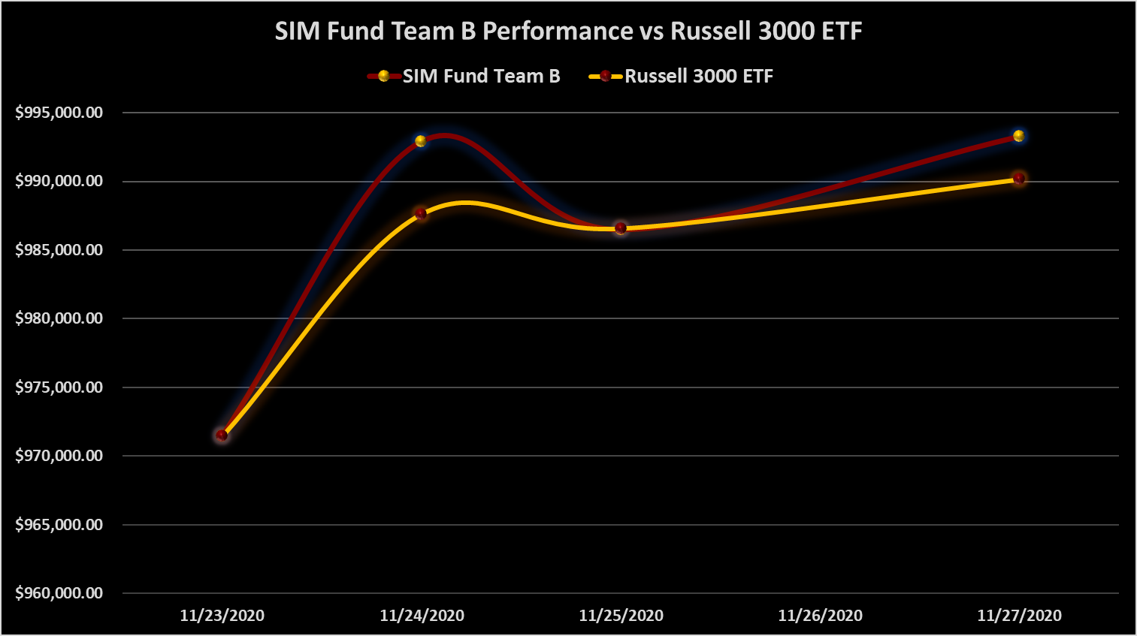
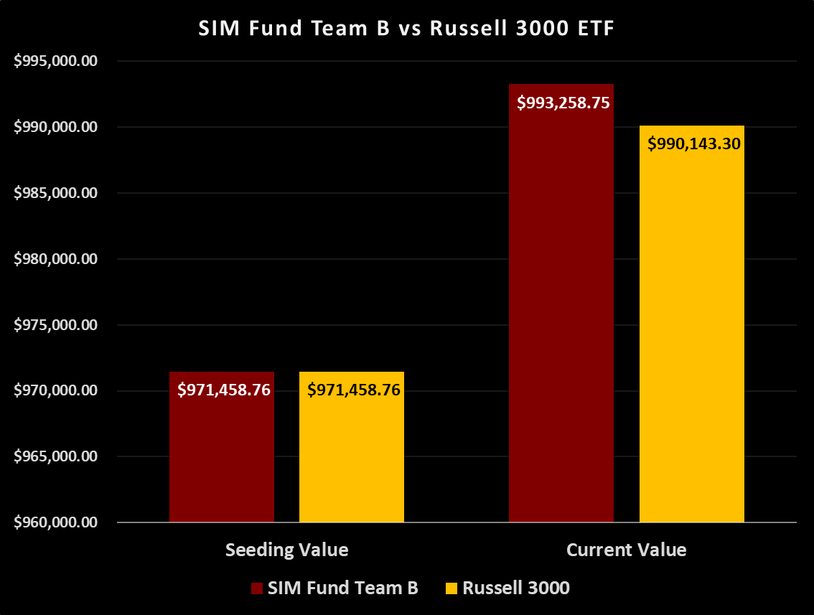
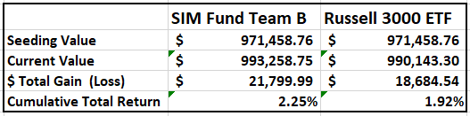
Portfolio Performance
Profitability
Profitability
Since the initial seeding on 11/23/2020, the portfolio has generated a 2.25% return compared to the Russell 3000 ETF’s 1.92% return.

Slide 38


Slide 39
APPENDIX

Slide 40
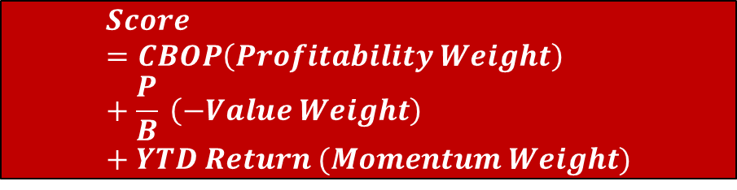
Example
$$Score=CBOP\left(Profitability Weight\right)+\frac{P}{B} \left(−Value Weight\right)+YTD Return (Momentum Weight)$$
Stock - Netgear Inc. (NTGR)
CBOP Ratio = 0.03
P/B Ratio = 1.45
YTD Return = 26.40%
$$−0.37=0.03\left(0.5\right)+1.45 \left(−0.3\right)+0.264(0.2)$$
Score
CBOP
Value
Momentum
The highest 65 stocks according to score are ranked and selected after controlling for sector exposure.

Slide 41
Exclusions
Cash Based Operating Profitability Ratio or Free Cash Flow to Equity Ratio cannot be calculated.
Return on Equity < 0%
Exchange Traded Funds (ETFs)
Free Cash Flow to Equity Ratio < 0
Price to Book Ratio = 0
YTD Return < -20% or = 0%
Exclude if any of the following are true for a particular stock:

