Slide 1
W. P. Carey School of Business
INTRODUCTION
Undergraduate Maroon & Gold Value Fund
Semi-Annual Meeting
April 30th, 2010

Slide 2
Today’s Agenda
INTRODUCTION
Team introduction & fund objectives
Fund performance
Economic outlook & market overview
Portfolio structure decisions
Investment selection process
Investments to highlight:
POSCO (PKX)
Brookfield Properties (BPO)
Attribution analysis
Thesis overview
Lessons learned & conclusion

Slide 3
FUND
PERFORMANCE
Fund Performance
Spring Semester| Academic Year

Slide 4
Spring Semester (11/20/09 – 4/16/10)
FUND
PERFORMANCE
Trailed benchmark by 329 basis points
Reasons for underperformance
Certain stock selections that did not meet analyst expectations
Discussed later in investment highlights and attribution analysis
SIM Fund | IVV Benchmark
6.78% | 10.07%
4
Notes:
4

Slide 5
Aggregate Performance
FUND
PERFORMANCE
Percent Cumulative Return for the Period of 11/20/2009-4/16/2010
5
Notes:
5

Slide 6
Academic Year (10/26/09 – 4/16/10)
FUND
PERFORMANCE
Trailed benchmark by 185 basis points
Better aggregate performance than spring semester alone
SIM Fund | IVV Benchmark
9.66% | 11.51%
6
Notes:
6

Slide 7
Economic Overview
ECONOMIC
OVERVIEW
Report| Sectors

Slide 8
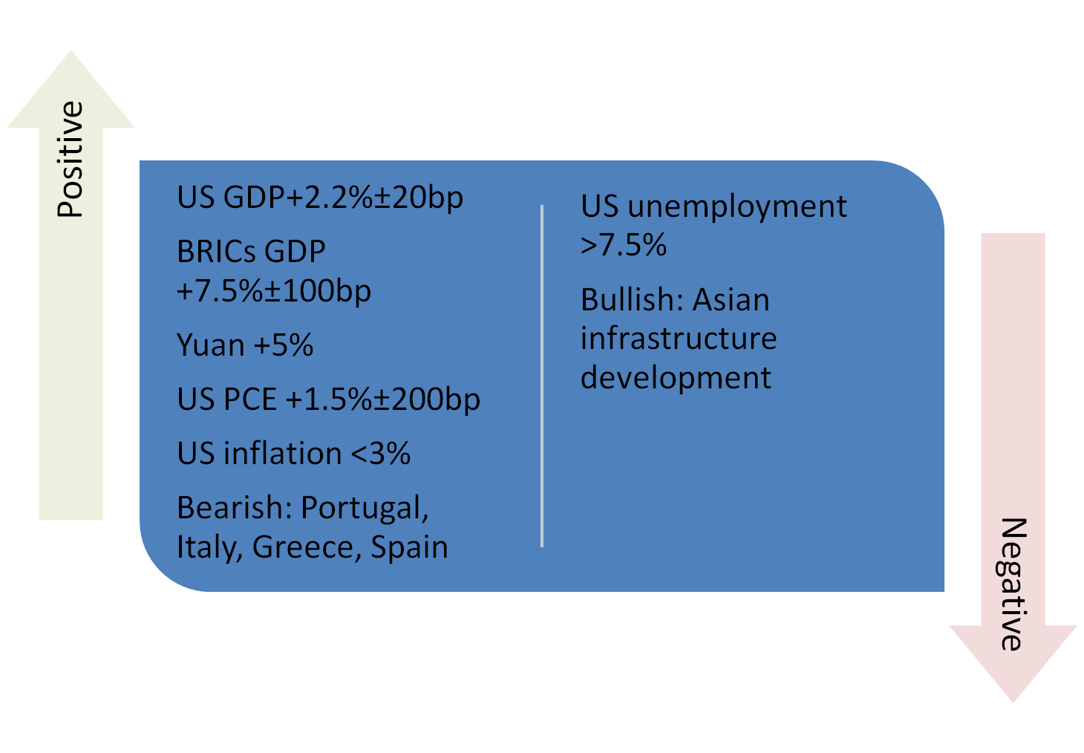
Economic Report
ECONOMIC
OVERVIEW
Notes:
8

Slide 9
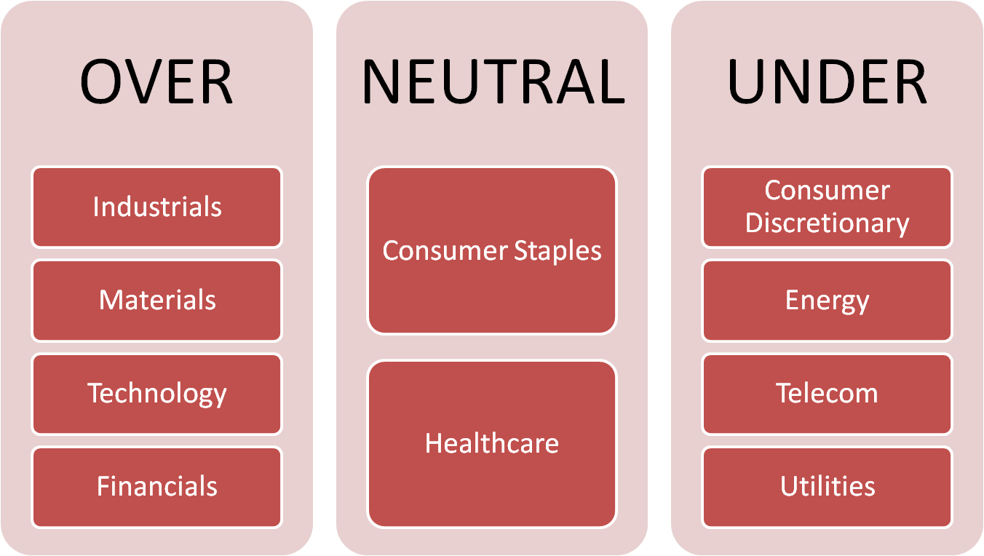
Sector Weightings
ECONOMIC
OVERVIEW
Equity
Fixed Income
9
Notes:
9

Slide 10
Portfolio Structural Decisions
PORTFOLIO
STRUCTURE
Portfolio | Allocation

Slide 11
Portfolio
Diversified, large-cap fund
Large-cap with market capitalization of $7bn+
Financially strong companies with concentration in those with strong access to U. S. capital markets and other G7 countries.
Companies able to take advantage of opportunities, especially those opportunities that present themselves in foreign markets
PORTFOLIO
STRUCTURE
11
Notes:
11

Slide 12
Allocation
Diversification
Strategy
9 sectors, 1 fixed income position
Sector analyst recommended weighting
Depended on our economic view
PORTFOLIO
STRUCTURE
12
Notes:
12

Slide 13
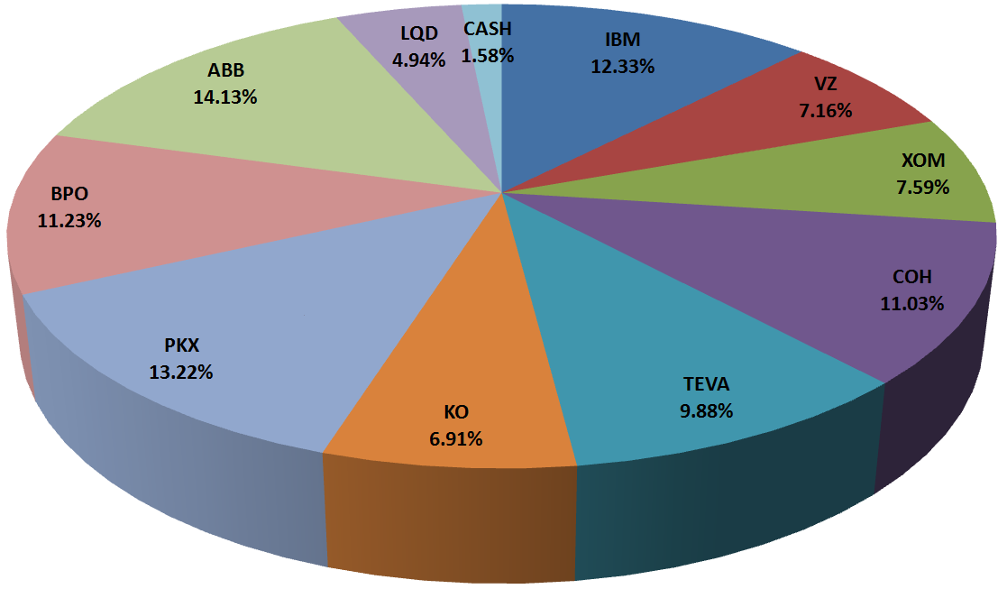
Allocation
By Market Value
PORTFOLIO
STRUCTURE
13
Notes:
13

Slide 14
Investment Selection Process
SELECTION
PROCESS
Sector reports | Investment reports | Committee

Slide 15
Sector Reports
Implemented top-down analysis
Updated previous reports to include recent data
Determined view by examining:
Economic reports, performance charts, industry publications, Wall Street research reports, major companies reported earnings
SELECTION
PROCESS
15
Notes:
15

Slide 16
Investment Reports
Industry overview
Fundamental analysis
P/E, P/B, Revenue Growth, ROE
Company changes from last semester
Did the fundamentals of the company change?
Does it fit with the new economic outlook?
Are there better opportunities within the sector?
Buy/Hold/Sell recommendation
SELECTION
PROCESS
16
Notes:
16

Slide 17
Committee, Monitoring
Committee decision
Vetting process/due diligence
Majority consensus
Monitoring
Company briefings & industry updates
SELECTION
PROCESS
17
Notes:
17

Slide 18
Stocks to Highlight
POSCO (PKX) | Brookfield Properties (BPO)
INVESTMENT
HIGHLIGHTS

Slide 19
POSCO (PKX)
Holding Period Return= -.82%
INVESTMENT
HIGHLIGHTS

Slide 20
POSCO (PKX) – Reasons for purchase
Exposure to China, India growth projects
Steel attractive over other basic materials
Leader in operational efficiency, room for margin growth
INVESTMENT
HIGHLIGHTS
20
Notes:
20

Slide 21
POSCO (PKX) – Holding Period Events
China steel contract renegotiation
Korean Won appreciated 5% against dollar
Daewoo acquisition negotiations
Economic recovery in BRIC nations sustained high volumes of sales
INVESTMENT
HIGHLIGHTS
21
Notes:
21

Slide 22
POSCO (PKX) – Performance against peers
INVESTMENT
HIGHLIGHTS
22
Notes:
22

Slide 23
Brookfield Properties (BPO)
Holding Period Return: +17.64%
INVESTMENT
HIGHLIGHTS

Slide 24
Brookfield Properties (BPO)
Reasons for Commercial Real Estate Exposure
Credit Spreads on CMBS were tightening
Significant headline risk priced into stock
Empire State Manufacturing Survey and Philadelphia Fed manufacturing index showed improvement
INVESTMENT
HIGHLIGHTS
24
Notes:
24

Slide 25
Brookfield Properties (BPO)
Reasons for BPO Purchase
Premier tenants in high growth industries; financials, energy & professional services
Heavy exposure to downtown cores in supply constrained markets
Average 95% occupancy
Rated BBB (high) by DBRS Credit Rating Agency
Above average market capitalization
INVESTMENT
HIGHLIGHTS
25
Notes:
25

Slide 26
Attribution Analysis
Weighted Portfolio Return
ATTRIBUTION
ANALYSIS

Slide 27
Weighted Portfolio Return
ATTRIBUTION
ANALYSIS
Portfolio Return - Benchmark Return = Total Return Difference
6.78% - 10.07% = -3.29%
**Based on holding period of Fifth-Third report (Holding Period 11/20/2009-4/16/2010)
27
Notes:
27

Slide 28
Thesis Overview
Earnings Performance and its Correlation with Voting Premiums in Dual-Class Equity Structures
Overview| Results
THESIS
28
Notes:
28

Slide 29
Overview
Approximately 7% of all companies use the dual-class equity structure
Positives of the dual-class equity structure:
Avoid corporate takeovers and encourages entrepreneurial management style
Negatives of the dual-class equity structure:
Poor corporate governance
Founders retain independence and control
Heavy reliance by technology and journalism industry
THESIS
29
Notes:
29

Slide 30
Results
Sample spread history exhibits 17.9% correlation with net income history
Sample spread history exhibits 42% correlation with EBIT history
THESIS
30
Notes:
30

Slide 31
Lessons Learned & Conclusion
CONCLUSION

Slide 32
Lessons Learned
Investment Horizon
Long-term capital market assumptions
Relatively short holding period
Fund personnel turnover
Maintain consistency
Analyst Expectations
Unexpected deviations from projections
Market impacts
Surprise events
CONCLUSION
32
Notes:
32

Slide 33
Lessons Learned
Battling Groupthink
Continuously addressing – poses greatest risk
Potential solutions
Risk Analyst
Competing analyst reports
Going Forward
Portfolio to remain invested
Longer period for investments to mature
Expanded fund
Increased learning opportunities
Exciting changes
CONCLUSION
33
Notes:
33

Slide 34
Appendices
Fund Holdings | Transaction History
Sector Return | Resumes
APPENDICES

Slide 35
Fund’s Current Holdings
International Business Machines (IBM)
Verizon Wireless (VZ)
Exxon Mobile (XOM)
Coach (COH)
Teva Pharmaceutical (TEVA)
The Coca-Cola Company (KO)
POSCO (PKX)
Brookfield Properties (BPO)
ABB Ltd. (ABB)
IBoxx Investment Grade Corporate Bonds (LQD)
APPENDICES

Slide 36
Transaction History
Buys (Returns current as of market close 4/27):
IBM (10/26): 110 shares @ $120.36, return: +7.02%
AXP (10/26): 320 shares @ $34.58, sold
VZ (10/26): 290 shares @ $29.00, return: -0.86%
XOM (10/26): 100 shares @ $73.81, return: -7.50%
BHP (10/26): 140 shares @ $73.66, sold
COH (10/26): 330 shares @ $34.22, return: +22.64%
DHR (10/26): 120 shares @ $70.00, sold
TEVA (10/26): 200 shares @ $50.30, return: +18.68%
CVS (10/26): 250 shares @ $37.16, sold
KO (11/30): 175 shares @ $56.97, return: -7.19%
PKX (02/03): 90 shares @ $120.08, return: -4.03%
BPO (02/24): 780 shares @ $13.15, return: +19.39%
ABB (02/24): 680 shares @ $19.72, return: -0.25%
APPENDICES

Slide 37
Transaction History
Buys (Continued):
XOM (02/24): 20 shares @ $64.91, return: +5.17%
PKX (02/24): 30 shares @ $116.45, return: -1.04%
LQD (02/24): 50 shares @ $104.65, return: +1.69%
Sells:
CVS (11/10): 250 shares @ $30.15, return: -18.86%
BHP (02/03): 140 shares @ $72.95, return: -0.96%
AXP (02/24): 320 shares @ $38.15, return: +10.32%
DHR (02/24): 120 shares @ $74.66, return: +6.65%
VZ (02/24): 30 shares @ $28.81, return: -0.65%
COH (02/24): 50 shares @ $36.61, return: +6.98%
TEVA (02/24): 30 shares @ $60.00, return: +19.28%
KO (02/24): 40 shares @ $55.00, return: -3.45%
APPENDICES
37
Notes:
37

Slide 38
OVER-PERFORM
NEUTRAL
UNDER-PERFORM
APPENDICES

