Slide 1
INTRODUCTION
Undergraduate Student Investment Management Fund
Semi-Annual Presentation
Friday, April 26th, 2013

Slide 2
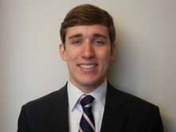
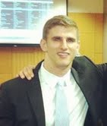
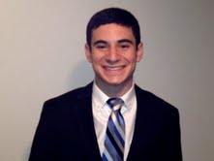
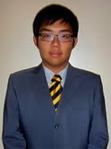






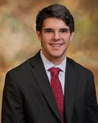



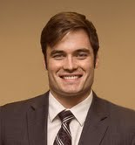
Fund Members
INTRODUCTION
Fund Managers
Fund Analysts
Aaron Baker
Kai Lam
Yili Yu
Andrew Farber
Clayton Jenners
Kenneth Qian
Jaesung Lee
Leo Panopoulos
Dakota Boyd
Dylan King
Lorne Forcum
Troy Hebert
Adrian Reiter
John Happe
Brian Wright

Slide 3
Portfolio Strategy and Construction
REVIEW
Two Portfolio Strategies:
  Passive Portfolio
    Market weighted
    Contains multiple asset classes
  Active Portfolio
    Incorporates information on insider transactions
    100% U.S. equity
Rebalancing

Slide 4
Passive Portfolio Overview
REVIEW
Initially represented 70% of our overall portfolio value
Goals
  Highly diverse, global
  Low cost
  Easily scalable
  International tilt
Notes:
Also, have the ability to accommodate any changes we might decide to make to the active portfolio’s allocation

Slide 5
Passive Portfolio
Strategy and Asset Classes
REVIEW
One US instrument and one international instrument per asset class (equity, bond, REIT)
Equities
  iShares FTSE All World Ex-US (VEU)
  Schwab US Broad Market (SCHB)
Bonds
  iShares Barclays Intermediate Credit (CIU)
  Vanguard Total Bond Market (BND)
REITs
  Vanguard REIT Index (VNQ)
  SPDR Dow Jones International Real Estate (RWX)
Notes:
ETF’s chosen based on their low expense ratios and ability to meet the investment goals of our passive portfolio

Slide 6
Active Portfolio
Insider Trading
REVIEW
Initially represented 30% of our total portflio value
Use information on insider positions to determine which stocks to purchase
Hold 40 securities in active portfolio
Purchase top 10 firms ranked by net number of opportunistic buyers (# insiders buying - # insiders selling) each week
Hold each stock for 4 weeks
Notes:
CEOs, and other insiders may know information that the general public does not know
Insiders: directors, officers, shareholders with controlling interest (10% or more), temperorary insiders
All companies, domestic and foreign, must file their registration statements electronically so that they can be posted on the SEC’s EDGAR database – includes IPO, proxy statements, annual reports.
Helpful Facts for Questions:
SEC form 3 is filed for initial ownership; SEC form 4 resembles open market buy or sell of a stock; form 5 represents transactions that should have been reported under form 4, but were legally deferred -> includes very “Small” transactions; form 144 deals with the sell of restricted securities in the open market place -> restricted securities are those acquired through special private offerings, such as employee benefit plans, regulation D offerings, or in exchange for “seed money” to a company. For our purposes, the only relevant form was SEC form 4.
Form 4 filings include any change in an ownership position, such as through a purchase, sale, option grant, option exercise, gift

Slide 7
Rebalancing
The fund made the decision to rebalance the active portfolio so that it would represent 50% of our total portfolio value
This process began on 2/11/13 and was completed on 3/5/13 (4 weeks)
REBALANCING

Slide 8
Rebalancing Method
Purchase a larger amount of the ten individual stocks in the active portfolio
Each week, sell the stocks that we had purchased 4 weeks prior
Gradually liquidate position in SCHB ETF (U.S. Broad Market)
Process was completed on 3/5/13
REBALANCING
Notes:
Recall that one goal of the passive portfolio was to accommodate changes that would might make to active portfolio’s alloc
Previously had been purchasing 7.5% of total portfolio value in stocks each week
Now purchase 12.5% of total portfolio value in stocks
Liquidate SCHB to make up the difference between weekly sale proceeds and weekly investment
Buying 12.5% of total portfolio value, selling 7.5%

Slide 9
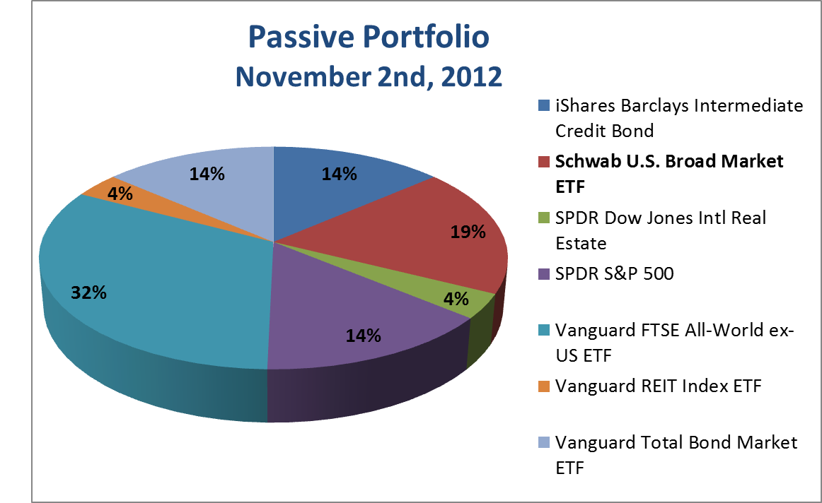
Initial Weights
REBALANCING

Slide 10
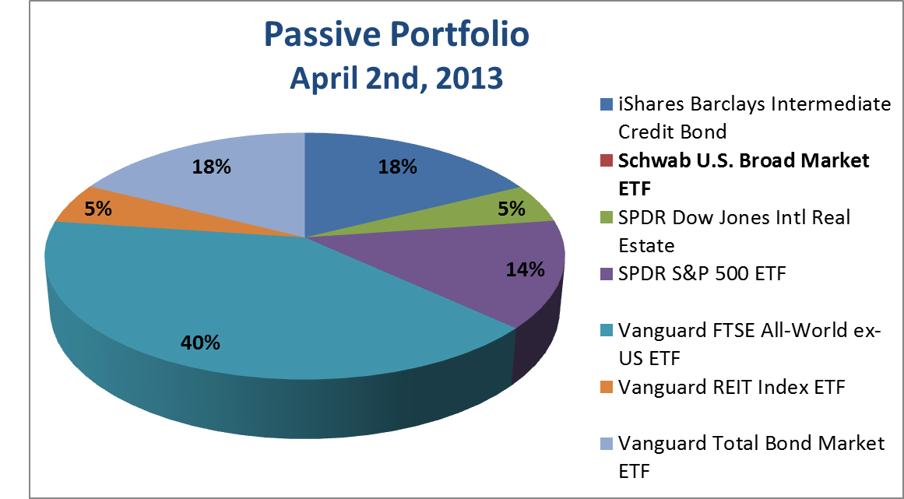
Final Weights
REBALANCING

Slide 11
Performance
Total Portfolio vs. Russell 3000
Total Portfolio vs. Custom Benchmark
Active Portfolio vs. Russell 3000
Portfolio Statistics
PERFORMANCE

Slide 12
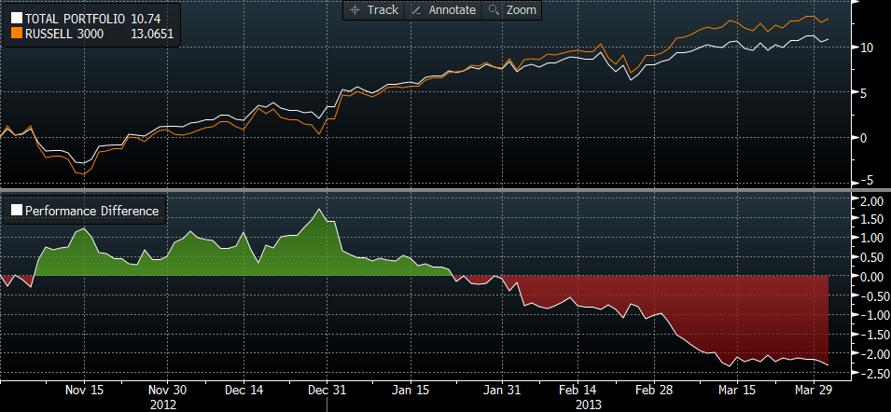
Total Portfolio vs. Russell 3000
PERFORMANCE
Notes:
Russell 3000, benchmark provided* by our charter
Explain how chart works.
Outperformed at first then underperformed.
Mainly due to differences in composition of asset class, not a great comparison.

Slide 13
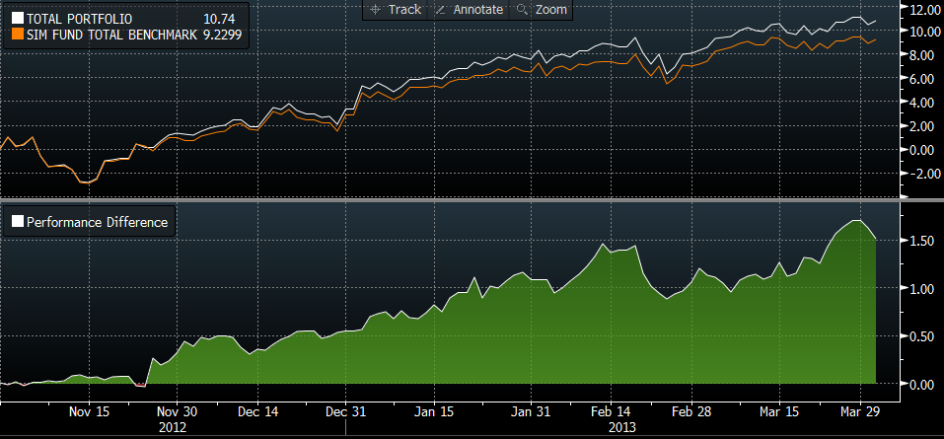
Total Portfolio vs. Custom Benchmark
PERFORMANCE
20% Barclays U.S. Aggregate, 25% FTSE Index, 55% Russell 3000
Notes:
20% Barclays US Aggregate, 25% FTSE Index, 55% Russell 3000
Has a similar composition to the total portfolio.
Outperformed due to our active portfolio.
What we really want to know is how did the active perform, since it was the focus of our fund.

Slide 14
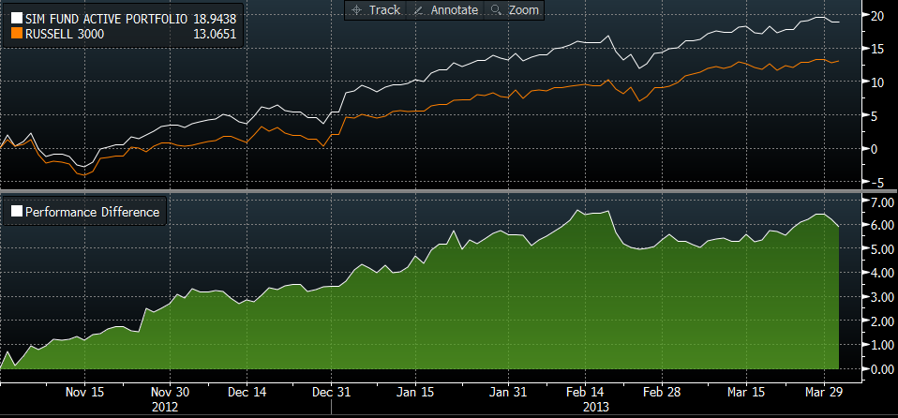
Active Portfolio vs. Russell 3000
PERFORMANCE
Notes:
It out performed the Russell 3000 by 6 percent over the 5 week period.
Question about Beta: next slide.

Slide 15
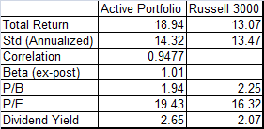
Portfolio Statistics
PERFORMANCE
Notes:
Explain chart
Really interesting, Beta is 1.01, so excess returns are not just leverage in an up market.
P/B and P/E mixed, so comparable growth/value to Russell 3000
Higher Div Yield may have something to do with special dividends.

Slide 16
Attribution
Active Sector Attribution
Sector Attribution vs. Russell 3000
Active Size Weights
Active Size Attribution
ATTRIBUTION

Slide 17
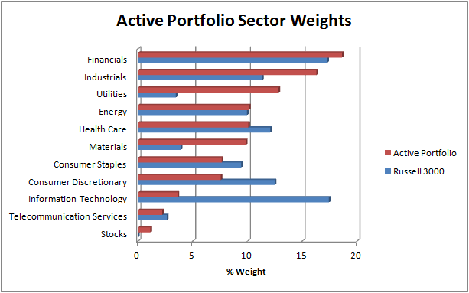
Sector Attribution vs. Russell 3000
ATTRIBUTION
Notes:
Explain Chart
Active sector distribution similar to Russell 3000
Main differences, underweight Information Technology, overweight utilities –What was that unregulated utility called?.

Slide 18
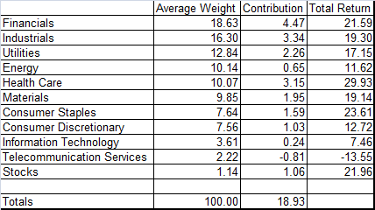
Active Sector Attribution
ATTRIBUTION
Notes:
Explain chart
Interesting: IT, and Tele are lowest weight and performed poorly
Stocks are companies that are no longer listed because they were acquired.

Slide 19
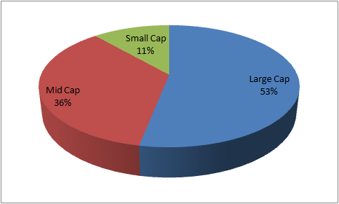
Active Size Weights
ATTRIBUTION
Notes:
Buckets were 2-5 Billion
Few small caps, requirement to invest in companies 1billion+, we chose universe of 1.2billion+
Biggest factor: larger companies have more insiders, report more, ranked higher for trades, results in more buys.

Slide 20

Active Size Attribution
ATTRIBUTION
Notes:
Explain chart

Slide 21
Hypothetical Scenarios
Holding Period Analysis
Long/Short Portfolio
Margin Calls
HOLDING PERIOD
Notes:
Still needs new name
Introduce holding period analysis

Slide 22
Holding Period Analysis
HOLDING PERIOD
Notes:
The analysis used back test data from weeks 1 to 62
Optimal holding period would be 1 week, if fund had implicit costs more weeks could be added.
If we ran it daily instead of weekly then maybe we could pick up some of the return prior to the signal.
90% CI
1 week annualized 19%
1-4 weeks annualized 9%

Slide 23
SHORT SCENARIO
Short Portfolio
  100% Active Short Portfolio
Long/Short Portfolio
  50% Long, 50% Short
Total Portfolio
  50% Active Long/Short, 50% Passive
SHORT SCENARIO
Notes:
Last presentation we were asked the question of performance of 3 hypothetical scenarios:
1) How the short portfolio alone performed – assumes 100% short active portfolio
2) Active Long/Short – If we created a portfolio using the opportunistic buys and opportunistic sells weighted at 50/50 – no passive portfolio.
3) Created active portfolio based on both sells and buys combined with passive
1) With friction – includes margin calls
2) Without friction – no transactions costs or margin calls
Similar to opportunistic buys, the short portfolio consists of pulling the top 10 opportunistic sell signals.

Slide 24
Short Portfolio Returns
SHORT SCENARIO
Notes:
Short Graph Sheet

Slide 25
Long/Short Portfolio
SHORT SCENARIO
Notes:
Long Short Graph Sheet

Slide 26
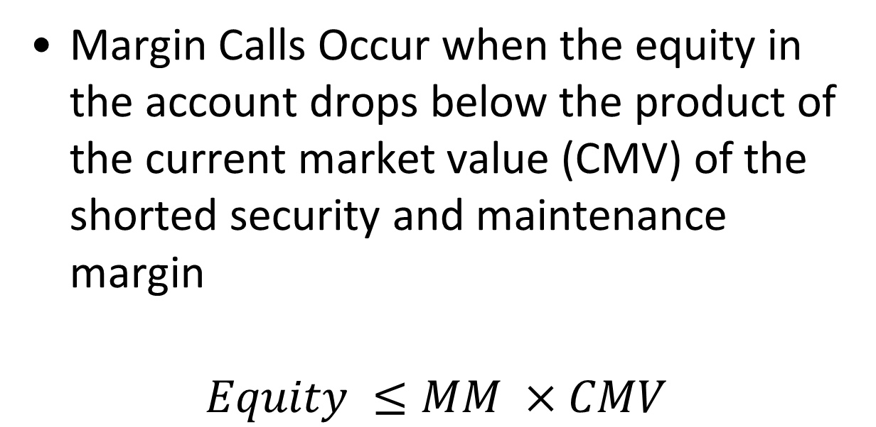
Margin Call Analysis
Margin Calls Occur when the equity in the account drops below the product of the current market value (CMV) of the shorted security and maintenance margin
$$Equity ≤MM ×CMV$$
SHORT SCENARIO

Slide 27
Margin Call Analysis
Assumptions:
Initial Margin (IM): 50%
Maintenance Margin (MM): 30%
SHORT SCENARIO

Slide 28
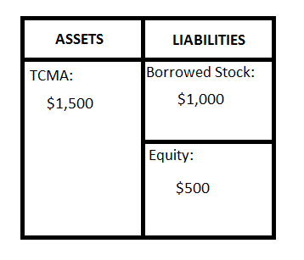
Margin Call Analysis
Example of Shorting Stock:
Short 100 Shares of ABC at $10 a share
Required to post 50% Equity (Reg-T)
SHORT SCENARIO
Notes:
TCMA – Total Cash Margin Account

Slide 29
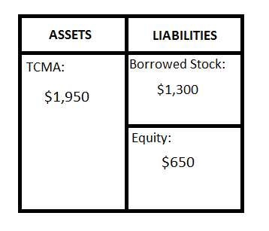
Margin Call Analysis
Example of Shorting Stock:
Price increase to $13/share
Amount to be paid back:
$13 x 100 shares = $1300
Equity decreases to $200 ($1500 - $1200 = $300)
Margin call occurs:
  30% x $1300 = $390
  $200 < $390
Required to bring equity to initial margin
SHORT SCENARIO
Notes:
Must bring back to 50%.
Current Market Value of Borrowed stock x 50% (original margin requirement) – Equity in the Account

Slide 30
Margin Calls
Date | Ticker | Magnitude
11/30/2012 | ATML | $1,017.90
12/11/2012 | HRG | $1,405.53
1/14/2013 | HPQ | $1,237.11
1/14/2013 | DK | $992.67
1/22/2013 | PCYC | $1,057.35
2/1/2013 | VLO | $1,023.78
2/13/2013 | MAS | $1,023.00
3/8/2013 | DF | $1,764.00
SHORT SCENARIO

Slide 31
Total Portfolio Returns
SHORT SCENARIO
Notes:
TOT Graph Sheet

